Slide 1

NYSL WebApp
Northside Youth Soccer League

Slide 2
Personas & Scenarios
Sarah Connor, a working mom who has to balance the weekend schedules of three kids. Needs to know the fields locations. May have kids in different teams.
Bob Builder, a parent volunteer at games. Needs to know location and time of the matches he is volunteering on.
Chris Pinecone, a 13-year-old team member who plays intensely. He wants to know which team is he playing against next weekend.

Slide 3
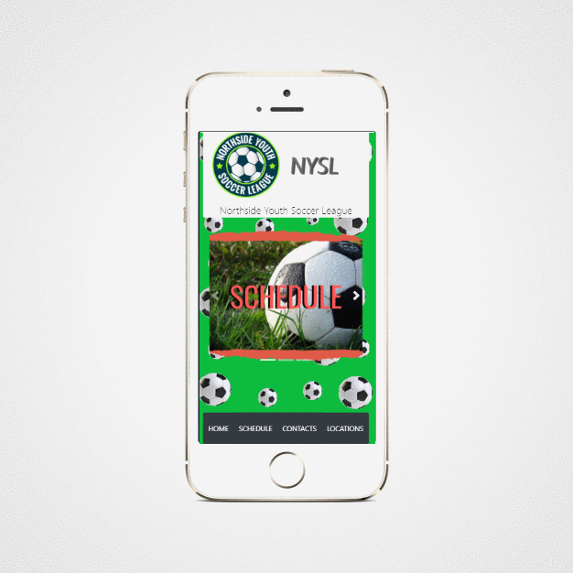
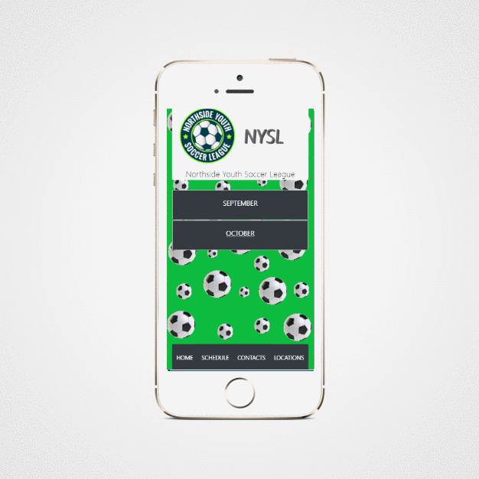
Home Screen
Schedule Screen

Slide 4




Tecnologías Aplicadas

